Slide 1


Python – Loops (iteration)
M M Mahbubul syeed, phd. Associate professor

Slide 2
Highlight
Loop – what is it!!??
Types of Loop.
Use of Loop with examples.
Understanding fundamental building blocks of loop.
Understand in detail how to construct a loop from a problem definition.
Distinction between loop and a conditional statement!

Slide 3
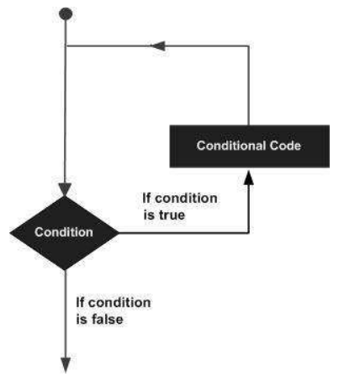
Loop

Slide 4
Loop – What is it?!
In general, statements are executed sequentially!
There are many situations when we need to execute a block of code several number of times.
A loop statement allows us to execute a statement or group of statements multiple times.

Slide 5
Type of Loops
Loop Type | Description
while loop | Repeats a statement or group of statements while a given condition is TRUE. It tests the condition before executing the loop body.
for loop | Executes a sequence of statements multiple times and abbreviates the code that manages the loop variable.
nested loops | You can use one or more loop inside any another while, or for loop.

Slide 6
while Loop

Slide 7
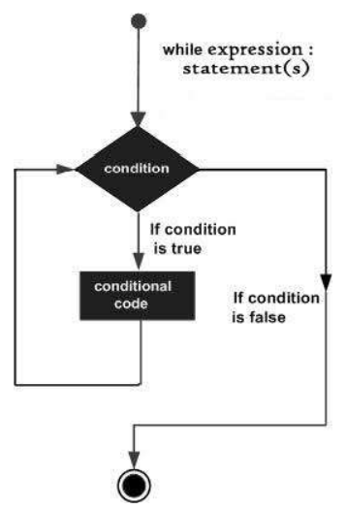
while Loop
A while loop statement in Python programming language repeatedly executes a target statement if a given condition is true.
Syntax
while expression:
statement(s)
Here,
statement(s) may be a single statement or a block of statements with uniform indent.
The condition may be any expression.
The loop iterates while the condition is true.
When the condition becomes false, program control passes to the line immediately following the loop.

Slide 8
while Loop
count = 0
while (count < 5):
print ('The count is:', count)
count = count + 1
print ("Good bye!")
Loop Condition
Loop Body
Must be indented
First instruction after Loop.
This instruction executed right after the loop ends.

Slide 9
while Loop
count = 0
while (count < 9):
print ('The count is:', count)
count = count + 1
print ("Good bye!")
Output:
Loop Condition
The count is: 0
The count is: 1
The count is: 2
The count is: 3
The count is: 4
The count is: 5
The count is: 6
The count is: 7
The count is: 8
Good bye!
Loop Body
Must be indented
First instruction after Loop.
This instruction executed right after the loop ends.

Slide 10
while Loop - Example
count = 0
while (count < 9):
print ('The count is:', count)
count = count + 1
print ("Good bye!")
Output:
Loop Condition
The count is: 0
The count is: 1
The count is: 2
The count is: 3
The count is: 4
The count is: 5
The count is: 6
The count is: 7
The count is: 8
Good bye!
Loop Body
Must be indented
First instruction after Loop.
This instruction executed right after the loop ends.

Slide 11

while Loop vs Conditional Statement
count = 0
while (count < 3):
print ('The count is:', count)
count = count + 1
print ("Good bye!")
count = 0
if (count < 3):
print ('The count is:', count)
count = count + 1
print ("Good bye!")
Output??
Output??

Slide 12
Loop – Example
Write a program in Python to display the first 10 natural numbers.
Write a Python program to find the sum of first 10 natural numbers.
Write a Python program to find the sum of series 1+3+5+7..+N.
Write a Python Program to find the sum of series 1^2+2^2+3^2...+N^2.
Write a Python Program to find the sum of series 1^1+2^2+3^3...+N^N
Write a Python Program to read the CGPAs of 5 students and print the max CGPA, min CGPA and average CGPA.
Write a Python program to display the cube of the number upto given an integer.
Write a Python program to display the multiplication table of a given integer.
Write a Python program to display the n terms of odd natural number and their sum.
Write a Python program to calculate the factorial of a given number.

Slide 13
Loop – Example
Write a program in Python to display the first 10 natural numbers.
Python code solution
start = 0
end = 9
while start <= end:
print(start)
start = start + 1
Your Idea

Slide 14
Loop – Example
2. Write a Python program to find the sum of first 10 natural numbers.
Python code solution
start = 1
end = 9
sum = 0
While start <= end:
sum = sum + start # sum += start
start = start + 1 # start += 1
print(‘Sum is: ’, sum)
Your Idea

Slide 15
Loop – Example
3. Write a Python Program to find the sum of series 1^2+2^2+3^2...+N^2.
Python code solution
start = 1
end = int(input(‘Enter series end value: ’))
sum = 0
while start <=end:
sum = sum + pow(start, 2)
start +=1
print(‘Power summation is: ’, sum)
Your Idea

Slide 16
Loop – Example
5. Write a Python program to calculate the factorial of a given number.
Python code solution
Your Idea

Slide 17
Loop – Example (Solution sheet)
Problem: 1
Problem: 2
i =1
while i <= 10:
print(i)
i+=1
i =1
sum = 0
while i <= 10:
sum+=i
i+=1
print('Sum of 10 natural numbers are: ', sum)
Problem: 3
n = int(input('Enter Series end Number: '))
i=1
sum=0
while(i <= n):
sum +=i
i+=1
print(f'Sum of {n} natural numbers are: ', sum)

Slide 18
Loop – Example (Solution sheet)
n = int(input('Enter Series end Number: '))
i=1
sum=0
while(i <= n):
sum +=pow(i,2)
i+=1
print(f'Sum of {n} squared natural numbers are: ', sum)
Problem: 4
Problem: 8
multiTable = int(input('Which Multiplication table to generate: '))
i = 0
while(i <= 10):
print(f'{multiTable} x {i} = ', multiTable * i)
i+=1

Slide 19
Loop – Example (Solution sheet)
Problem: 10
count = 4
i = 1
fact = 1
while i <= count:
fact *=i
i +=1
print(f'Factorial of {count} is', fact)

Slide 20
Loop – Example
(Solution sheet)
i = 1
min = 4
max = 0
avg = 0
while( i < = 5):
cgpa = float(input('Enter CGPA: '))
# calculating minimum
if cgpa < min: min = cgpa
#calculating maximum
if cgpa > max: max = cgpa
#calculating average
avg += cgpa
i+=1
avg = avg / (i-1)
print('i = ', i)
print('mIn CGPA = ', min)
print('Max CGPA = ', max)
print('Avg CGPA = ', avg)
Problem: 6
Write a Python Program to read the CGPAs of 5 students and print the max CGPA, min CGPA and average CGPA.

Slide 21
while Loop – infinite loop
A loop becomes infinite loop if a condition never becomes FALSE.
This results in a loop that never ends.
Such a loop is called an infinite loop.
An infinite loop might be useful in client/server programming where the server needs to run continuously so that client programs can communicate with it as and when required.

Slide 22
while Loop – infinite loop
A loop becomes infinite loop if a condition never becomes FALSE.
This results in a loop that never ends.
This condition never turns False!
var = 1
while var == 1 : # This constructs an infinite loop
num = int(input("Enter a number :"))
print ("You entered: ", num)
print ("Good bye!")

Slide 23
while Loop – infinite loop
A loop becomes infinite loop if a condition never becomes FALSE.
This results in a loop that never ends.
Output:
var = 1
while var == 1 : # This constructs an infinite loop
num = int(input("Enter a number :"))
print ("You entered: ", num)
print ("Good bye!")
Enter a number :10
You entered: 10
Enter a number :10
You entered: 10
Enter a number :10
You entered: 10
Enter a number :23
You entered: 23
Enter a number :^C
Traceback (most recent call last):
File "c:\Users\M SYEED\OneDrive - American International University-Bangladesh\Desktop\Lab19\loop.py", line 3, in <module>
num = int(input("Enter a number :"))
EOFError

Slide 24
while Loop – infinite loop
A loop becomes infinite loop if a condition never becomes FALSE.
This results in a loop that never ends.
while True : # This constructs an infinite loop
num = int(input("Enter a number :"))
print ("You entered: ", num)
print ("Good bye!")
while 1 : # This constructs an infinite loop
num = int(input("Enter a number :"))
print ("You entered: ", num)
print ("Good bye!")
Press Ctrl + C to terminate the loop!

Slide 25
while Loop – infinite loop
i = 1;
while(i<10):
print("i value: ", i)
Output??
How many times it will print?
When will the program end?

Slide 26
while Loop – infinite loop
j = 1;
while ( j < 5 ):
print("j value: ", j)
Output??
How many times it will print?
When will the program end?

Slide 27
while Loop – infinite loop
Is there any difference between the two while loops?
Try to trace output and find the answer.
j = 1
while ( j < 5 ):
print("j value: ", j)
j = int(input('Number: '))
while ( j < 5 ):
print("j value: ", j)
j = int(input('Number: '))

Slide 28
Break statement in Loop

Slide 29
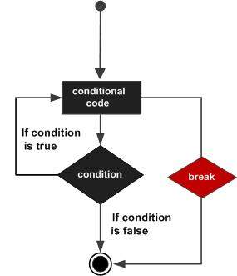
break statement with Loop
The break statement in Python terminates the current loop and resumes execution at the next statement, just like the traditional break found in C.
Syntax
while expression:
statement(s)
if condition:
break
statement(s)

Slide 30
break statement with Loop
i = 1
while i < 6:
print('i = ', i)
i+=1
if i == 3:
print('program breaks out from here!!')
break
print('The program ends.')
Output:
i = 1
i = 2
program breaks out from here!!
The program ends.

Slide 31
else clause with Loop
The else clause can be used with a loop statement in Python!
Else clause gets executed only if:
the loop has completed its execution fully without hitting a break statement / the loop ends normally.
Syntax
while expression:
statement(s)
else:
statement(s)

Slide 32
else clause with Loop - Example
i = 1
while i < 5:
print('i = ', i)
i+=1
else:
print('The loop executed successfully!')
print('The program ends.')
i = 1
while i < 5:
print('i = ', i)
i+=1
if i == 3:
break
else:
print('The loop executed successfully!')
print('The program ends.')
i = 1
i = 2
i = 3
i = 4
The loop executed successfully!
The program ends.
i = 1
i = 2
The program ends.

Slide 33
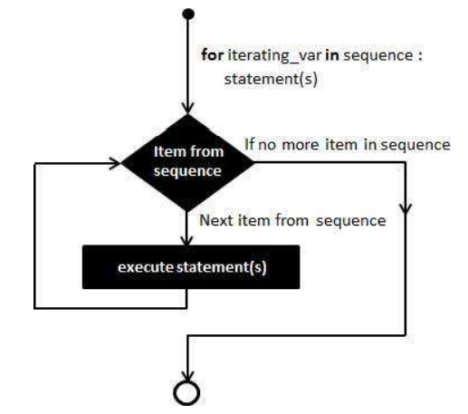
for Loop

Slide 34
for Loop
A for loop is used for iterating over a sequence.
a list
a tuple
a dictionary
a set
a string
This is less like the for in other programming languages,
and
Works more like an iterator method as found in other object-oriented programming languages.

Slide 35
for Loop
Syntax:
for iterating_var in sequence:
statements(s)

Slide 36
for Loop
Syntax:
for iterating_var in sequence:
statements(s)
for letter in 'Python':
print ('Current Letter :', letter)
fruits = ['banana', 'apple', 'mango']
for f in fruits: # traversal of List sequence
print ('Current fruit :', f)
print ("Good bye!")
Output??

Slide 37
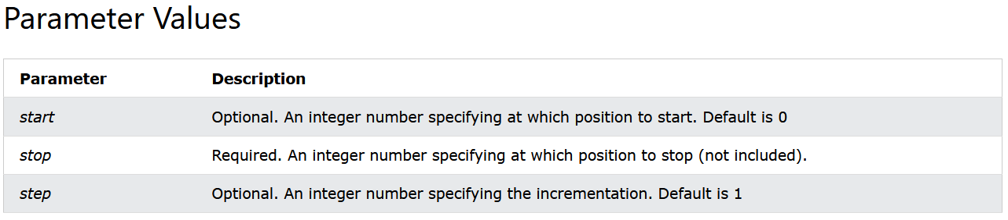
for Loop
Syntax:
for iterating_var in sequence:
statements(s)
The range() function:
This function can be used to iterate over a range of values in a sequence (e.g., list, tuples) of values.
Syntax:
range(start, stop, step)

Slide 38
for Loop
The range() function: This function can be used to iterate over a range of values in a sequence (e.g., list, tuples) of values.
Syntax:
range(start, stop, step)
for i in range(5):
print(i, end =' ')
print()
for i in range(3, 10):
print(i, end =' ')
print()
for i in range(5, 15, 2):
print(i, end =' ')
Output??
0 1 2 3 4
3 4 5 6 7 8 9
5 7 9 11 13

Slide 39
for Loop
Syntax:
for iterating_var in sequence:
statements(s)
The range() function: Example
Output??
print(range(5))
mylist = list(range(2,20,3))
print(mylist)
for i in mylist:
print(i)
range(0, 5)
[2, 5, 8, 11, 14, 17]
2
5
8
11
14
17

Slide 40
for Loop
The range() function: Example
Syntax:
fruits = ['apple', 'pineapple', 'banana', 'mango']
numbers = list(range(1,101,1))
for i in range(0,len(fruits),2):
print(fruits[i], end =' ')
print()
for j in range(0, len(numbers),2):
print(numbers[j], end = ' ')
print()
for j in range(1, int(len(numbers)//2),2):
print(numbers[j], end = ' ')
for iterating_var in sequence:
statements(s)
Output??
apple banana
1 3 5 7 9 11 13 15 17 19 21 23 25 27 29 31 33 35 37 39 41 43 45 47 49 51 53 55 57 59 61 63 65 67 69 71 73 75 77 79 81 83 85 87 89 91 93 95 97 99
2 4 6 8 10 12 14 16 18 20 22 24 26 28 30 32 34 36 38 40 42 44 46 48 50

Slide 41
Nested Loops

Slide 42
Nested Loop
Python programming language allows the use of one loop inside another loop. The following section shows a few examples to illustrate the concept.
Syntax:
while expression:
statement(s)
while expression:
statement(s)
statement(s)

Slide 43
Nested Loop
Write a program in Python to display the pattern like right angle triangle with a number.
The pattern like :
1
12
123
1234
Sketch Your solution here:

Slide 44
Nested Loop
The pattern like :
1
12
123
1234
n = int(input('Number of lines: '))
i = 1
while(i <= n):
j = 1
while j <= i:
print(j,end="")
j+=1
i+=1
print()
Write a code to create the pattern like :
1
2 3
4 5 6
7 8 9 10

